Slide 1
RELATION EXTRACTION WITH GRAPH NEURAL NETWORKS
S.NO | REG.NO | NAME | SECTION
1 | CB.EN.U4CSE19121 | Kesa Varshitha | CSE - B
2 | CB.EN.U4CSE19135 | N D N Jahnavi | CSE - B
3 | CB.EN.U4CSE19139 | R Sneha Nair | CSE - B
4 | CB.EN.U4CSE19148 | Sithara J P | CSE - B
PROJECT ADVISOR:
BINDU K.R.
ASST. PROFESSOR CSE
AMRITA VISHWA VIDYAPEETHAM
TAG – 2(AI)

Slide 2

Screen shot of Mail approval from guide

Slide 3
PROBLEM DEFINITION
To implement relation extraction using Graph neural networks in semi structured documents.

Slide 4
Literature Survey
S.No | PAPER NAME | AUTHOR NAME | ALGORITHM / METHOD USED | OPEN PROBLEM
1. | Graph Neural Networks with Generated Parameters for Relation Extraction (2019) | Hao Zhu, Yankai Lin, Zhiyuan Liu, Jie Fu, Tat-seng Chua, Maosong Sun | Graph neural network with generated parameters (GPGNNs) The parameters in the propagation module are produced by a generator taking natural language sentences as inputs. | The performance of relation extraction could be significantly improved by considering more multi hops in relational reasoning

Slide 5
S.No | PAPER NAME | AUTHOR NAME | ALGORITHM/METHOD USED | OPEN PROBLEM
2. | Graph Convolutional Networks for Named Entity Recognition (2017) | Cetoli, Alberto Bragaglia, Stefano O’Harney, Andrew Daniel Sloan, Marc Context Scout | Bi - Long short-term memory (Bi-LSTM) It enhance the performance of the model on sequence classification problems Bi - Graph Convolutional Networks (Bi-GCN) It binarizes both the network parameters and input node features. | Gating of the components of input vectors Neighbouring word prediction It cconsiders the last word of a particular sentence and predict the next possible word.

Slide 6
S.No | PAPER NAME | AUTHOR NAME | ALGORITHM/METHOD USED | OPEN PROBLEM
3. | Named Entity Recognition with Bidirectional LSTM-CNNs (2016) | Jason P.C. Chiu, Eric Nichols | Bidirectional LSTM Character-level CNN F1 Score - 91.62 | Extended tagset NER Named Entity Recognition (NER) tags sentences. The task is to tag each token in a given sentence with an appropriate tag. Entity linking Entity Linking (EL) recognizes and disambiguates named entities to a knowledge base.

Slide 7
S.No | PAPER NAME | AUTHOR NAME | ALGORITHM/METHOD USED | OPEN PROBLEM
4. | Named Entity Recognition and Relation Extraction with Graph Neural Networks in Semi Structured Documents (2021) | Manuel Carbonell, Pau Riba , Mauricio Villegas† , Alicia Fornes´, Josep Llados´ | k-NN graph Edges between words are created using k nearest neighbors (k-NN) based on the distances of the top-left corner of the word bounding boxes. BERT F1 SCORE ARI | Method has been initially designed for administrative document understanding, but it shown that it can be adapted to other domains, as for example historical manuscripts. Further research tuning the method and testing on larger data sets could confirm the feasibility of the approach as a generic solution for extracting structured information from semi-structured documents.

Slide 8
S.No | PAPER NAME | AUTHOR NAME | ALGORITHM USED | OPEN PROBLEM
5. | Context-Aware Representations for Knowledge Base Relation Extraction (2017) | Daniil Sorokin and Iryna Gurevych | LSTM-based encoder | Improvements can be done in the new neural network architecture for extracting relations between an entity pair that takes into account other relations in the sentence.

Slide 9
S.No | PAPER NAME | AUTHOR NAME | ALGORITHM USED | OPEN PROBLEM
6. | A Comprehensive Survey on Graph Neural Networks | Wu, Z., Pan, S., Chen, F., Long, G., Zhang, C. and Philip, S.Y., | Recurrent graph neural networks Convolutional graph neural networks Graph autoencoders Spatial-temporal graph neural networks. | Model depth: with an increase in infinite number of graphs convolutional layers, all nodes’ representations will converge to a single point. Scalability trade-off: Using sampling or clustering, a model will lose part of the graph Information, therefore how to trade-off graph integrity could be a question. Heterogeneity: It is difficult to directly apply current GNNs to heterogeneous graphs, containing different types of nodes and edges, or different forms of node and edge inputs. Dynamicity: New graph convolutions are needed to adapt to the dynamicity of graphs. Graphs are in nature dynamic in a way that nodes or edges may appear or disappear, and that node/edge inputs may change time by time.

Slide 10
S.No | PAPER NAME | AUTHOR NAME | ALGORITHM/METHOD USED | OPEN PROBLEM
7. | Generating knowledge graphs by employing Natural Language Processing and Machine Learning techniques within the scholarly domain (2020) | Danilo Dessì, Francesco Osborne, Diego Reforgiato Recupero, Davide Buscaldi, Enrico Motta | CSO TOOL Word2vec algorithm | A first limitation is that the current prototype can only extract one relationship between two entities. This is not completely realistic since two entities can be linked by many kinds of relationship . Second limitation is knowledge graph is not created by considering cross document relations (e.g., citations) to further link entities. A third limitation regards ability to recognize synonyms that are not defined in existent knowledge bases, such as CSO. A fourth limitation regards the scalability.it is very difficult to apply it on very large-scale datasets.

Slide 11
S.No | PAPER NAME | AUTHOR NAME | ALGORITHM USED | OPEN PROBLEM
8. | Incorporating Relation Paths in Neural ReClation Extraction (2017) | Wenyuan Zeng1 , Yankai Lin2 , Zhiyuan Liu2∗, Maosong Sun2 | Text Encoder - Given the sentence with two corresponding target entities, we use a CNN to embed the sentence into a semantic space, and measure the probability of each relation given this sentence. Relation Path Encoder- Given a relation path between the target entities, we measure the probability of each relation r, conditioned on the relation path. Joint Model - We integrate the information from both direct sentences and relation paths, then predict the confidence of each relation. | In the future, we will explore the following directions: (1) explore the combination of relation paths from both plain texts and KBs for relation extraction. (2) and also, may take advantages of probabilistic graphical model or recurrent neural network to encode more complicated correlations between relation paths, e.g., multi-step relation paths, for relation extraction.

Slide 12
S.No | PAPER NAME | AUTHOR NAME | ALGORITHM/METHOD USED | OPEN PROBLEM
9. | Named Entity Recognition as Graph Classification (2021) | Ismail Harrando, Rapha¨el Tronc | Binary Auto-encoder Node2Vec TransE GCN | Different architectures, hyperparameters fine-tuning, adding attention, changing the classifier Word Embeddings It is a numeric vector input that represents a word in a lower-dimensional space. Fine-grained entity typing The task of assigning a fine-grained type from a hierarchy to entity mentions in the text.

Slide 13
MOTIVATION
There is a considerable quantity of unstructured electronic material available on the Web.
A common concept is to arrange unstructured text by appending semantic information.
Due to large data, human annotation is not practicable.Instead, we would want a computer to automatically annotate every data with the structure we are interested in. This could be easily done using relation extraction
Relationship extraction is the task of extracting semantic relationships from a text..
Due to incorrect extraction of data, an NLP algorithm could be trained incorrectly, therefore extracting the most relevant relations in the texts is important.
The majority of NLP models are done mainly on three languages. Our main goal is to use an improved version of this methodology to translate Indian languages.

Slide 14
ABSTRACT
Entity-relationship extraction extracts semantic relationships from a text. These train the NLP-based AI models to understand the relationships with multiple entities in a text for the analysis of the extracted data.
Since graph neural network (GNN) can well learn the relationship between data elements in the document, it is proposed to use GNN to solve the problem of entity recognition (NER) and relationship extraction in documents.
The relation extraction task performs poorly on complex text. To solve this problem, we propose a novel joint model named extracting Entity-Relations via Improved Graph Attention networks, which enhances the ability of the relation extraction task.
Our model would demonstrate consistent performance improvements, without requiring heavy feature engineering nor additional language-specific knowledge.

Slide 15
ABSTRACT
Entity-Relationship Extraction:
Extracts semantic relationships from text
Trains NLP-based AI models for relationship understanding and Enables data analysis of extracted information
Graph Neural Networks (GNN) for NER and Relation Extraction:
GNN effectively learns relationships in documents
Proposed for entity recognition (NER) and relation extraction
Introducing a Joint Model: "Extracting Entity-Relations via Improved Graph Attention networks":
Addresses poor performance in relation extraction for complex text
GNNs improve entity recognition and enhances relation extraction task
Consistent performance improvements and enables understanding of text relationships
enhances performance without extensive feature engineering or language-specific knowledge

Slide 16
LANGUAGE & TOOLS
Language
Python
HTML
CSS
JavaScript
Tools
Spacy
NLTK
TensorFlow
Pandas

Slide 17
DATASET
The dataset consists of 172k Hindi Wikipedia articles.
The dataset contains input files in Hindi in the txt format.
Link to dataset - https://www.kaggle.com/datasets/disisbig/hindi-wikipedia-articles-172k

Slide 18
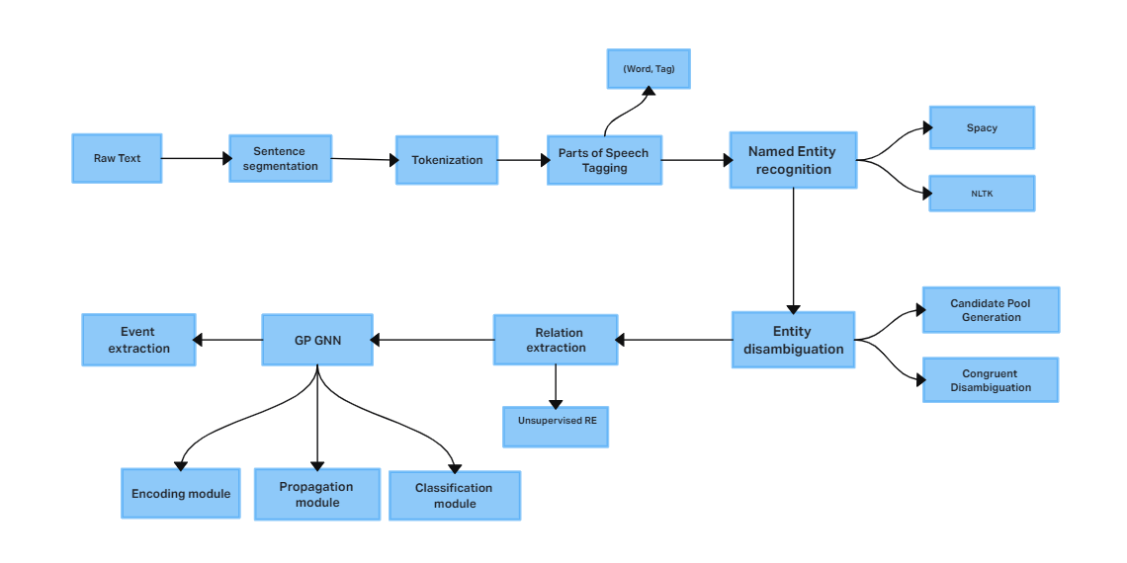
WORK PLAN

Slide 19
MODULES
Dataset preparation and preprocessing
Tokenization
Pos Tagging
Word grouping(keyword detection): Detecting document entities, i.e., grouping words with the same semantics
Handling Unknown pos tagging
Entity classification: Divides the detected entities into preset categories
Relationship prediction: Find pairing relationship between entities.
GP GNN algorithm

Slide 20
GP GNN(graph neural networks with generated parameters) algorithm
Graph neural networks with generated parameters (GP-GNNs) adapt graph neural networks to solve the natural language relational reasoning task. GP-GNNs first constructs a fully connected graph with the entities in the sequence of text. After that, it employs three modules to process relational reasoning: (1) an encoding module (2) a propagation module (3) a classification module. As compared to traditional GNNs, GP-GNNs could learn edge parameters from natural languages, extending it from performing inference on only non-relational graphs or graphs with a limited number of edge types to unstructured inputs such as texts.
A graph neural network with generated parameters (GPGNNs) is one of the most effective approaches for multi-hop relational reasoning in relation extraction.

Slide 21
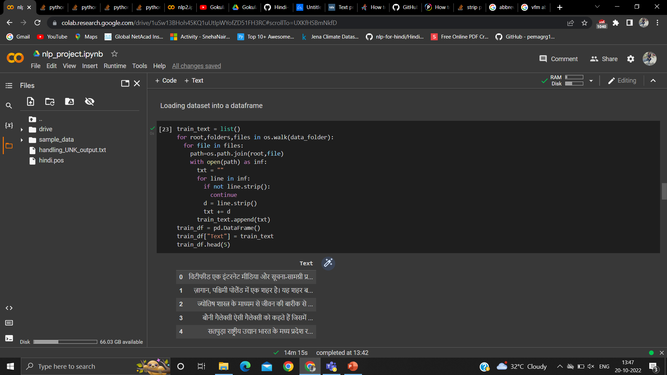
Loading dataset into a Dataframe

Slide 22
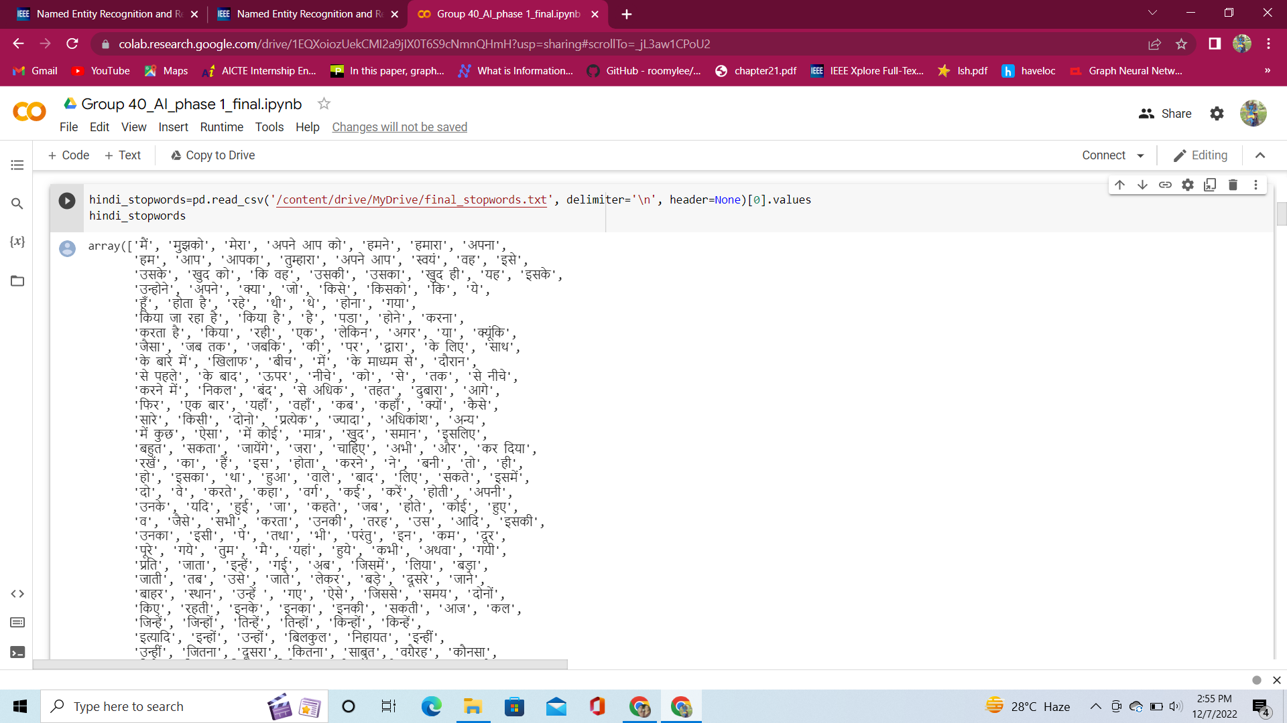
Removing Stop Words

Slide 23
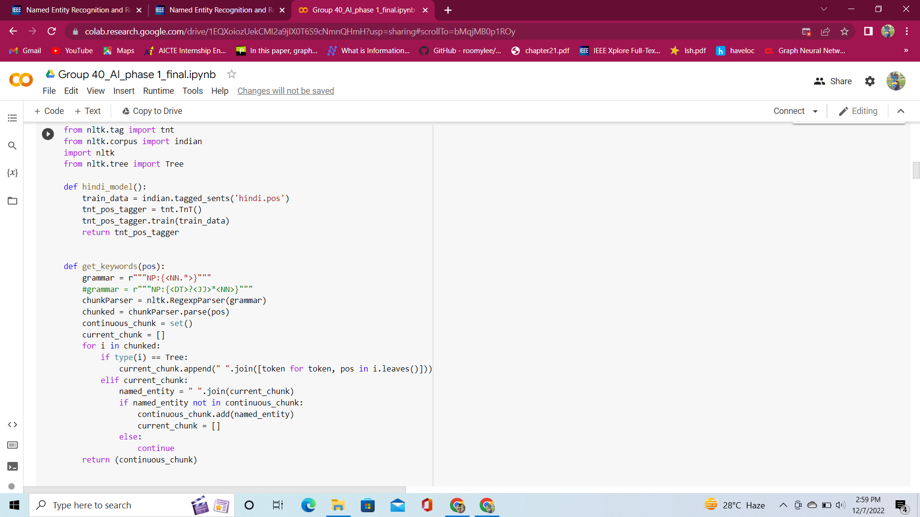
Tokenization and Keyword generation

Slide 24
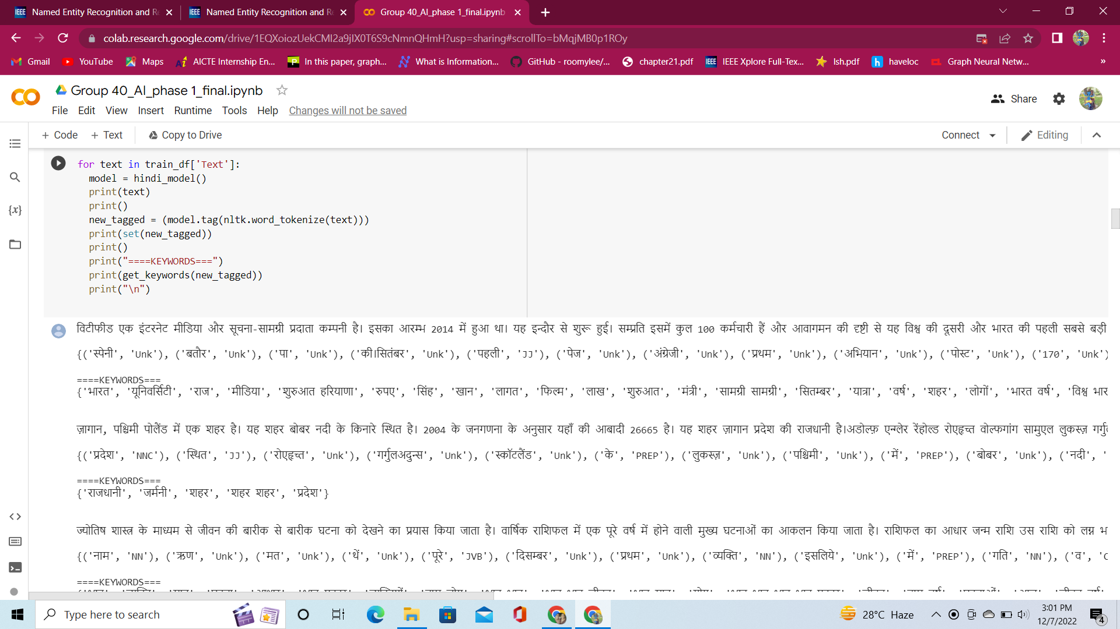

Slide 25
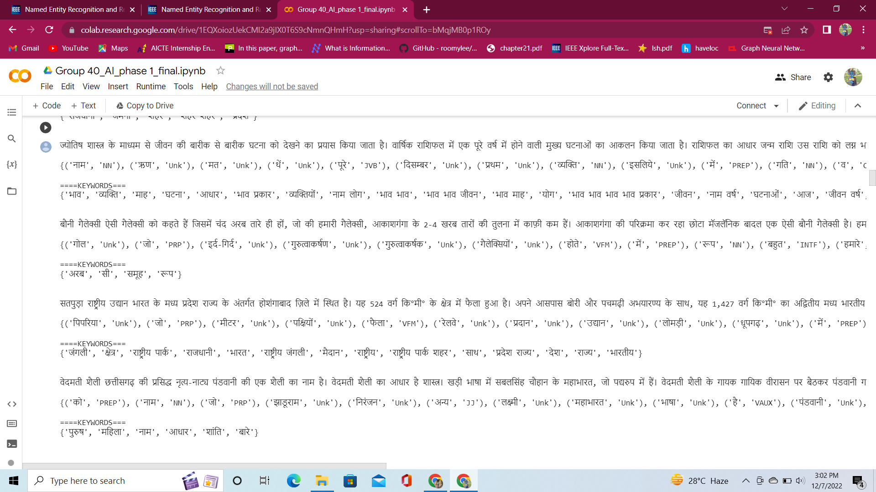

Slide 26
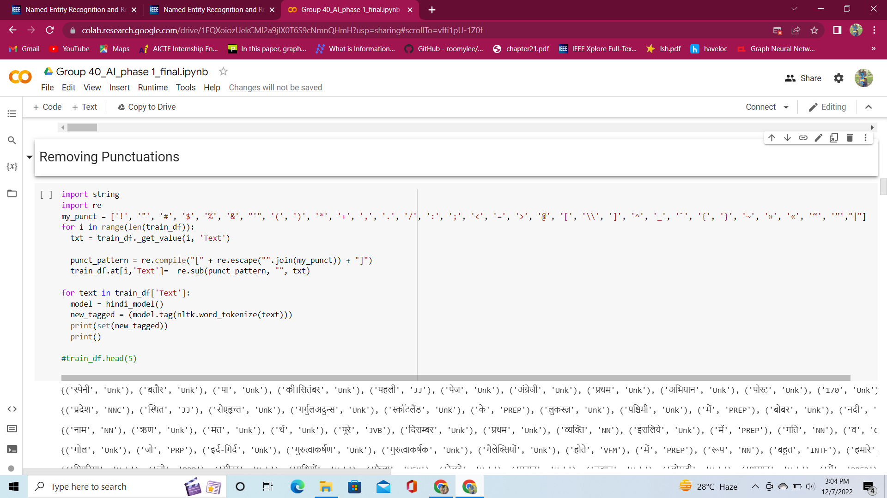
Removing Punctuations from the text

Slide 27
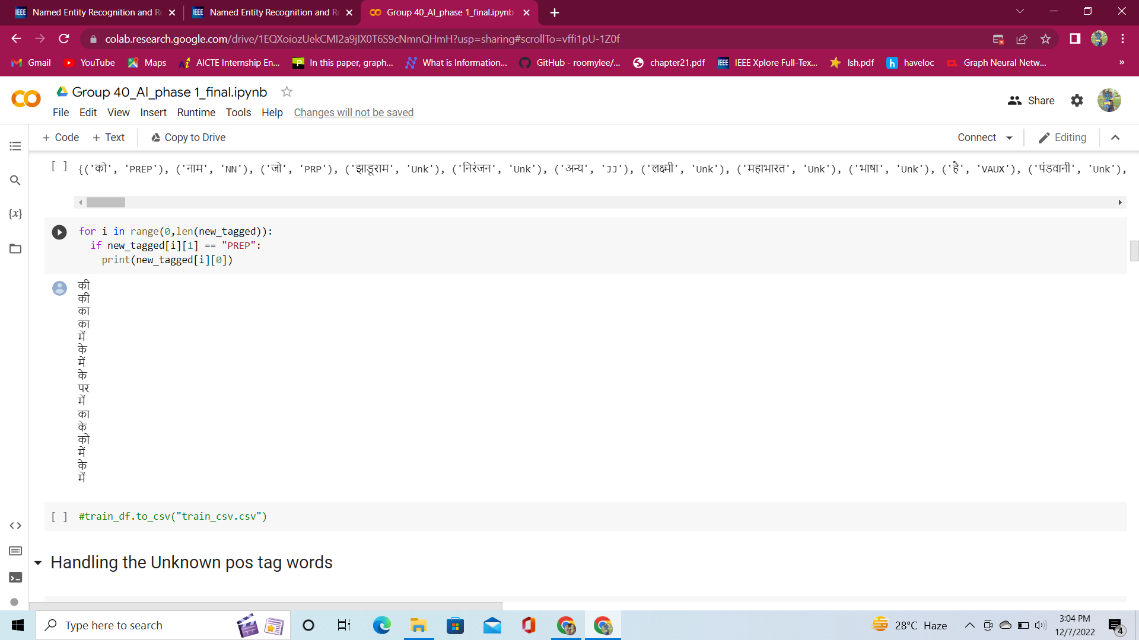

Slide 28
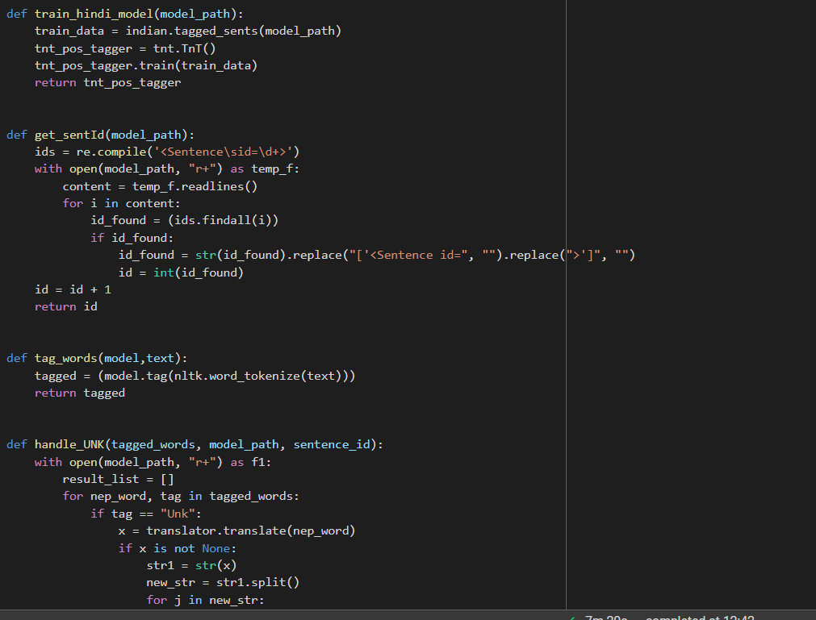
Handling the Unknown post tag words

Slide 29
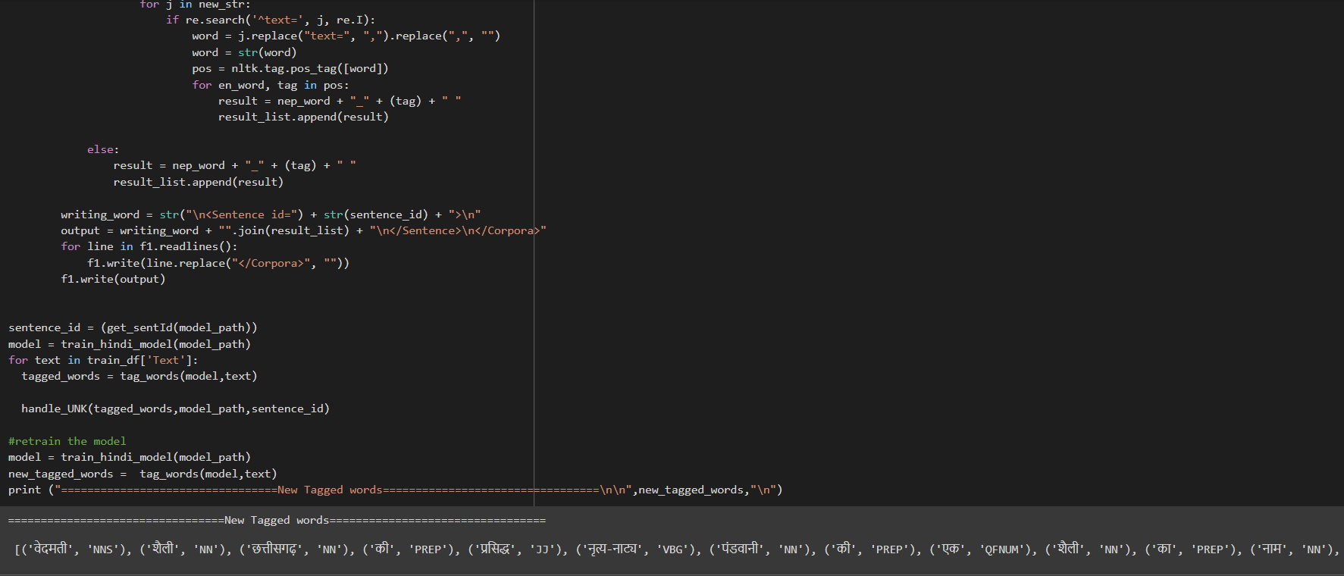

Slide 30
Named Entity Recognition

Slide 31
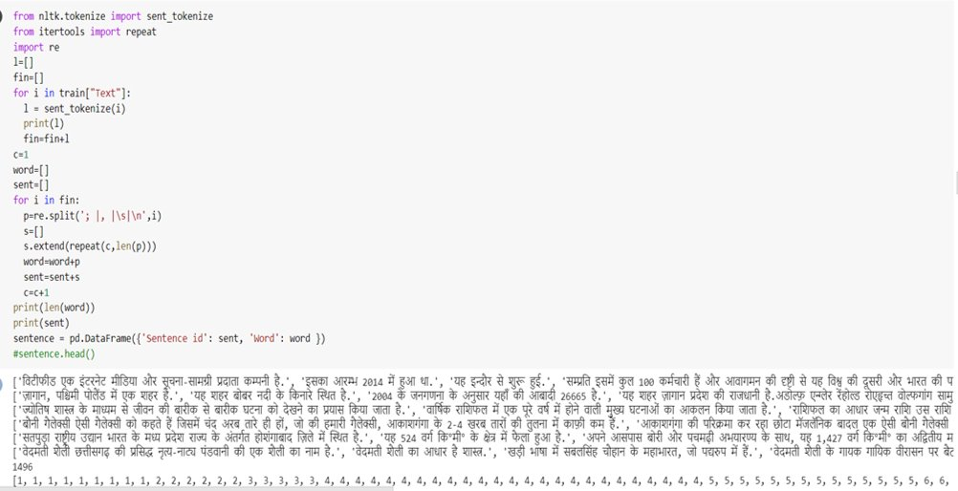
Splitting Data into Words

Slide 32
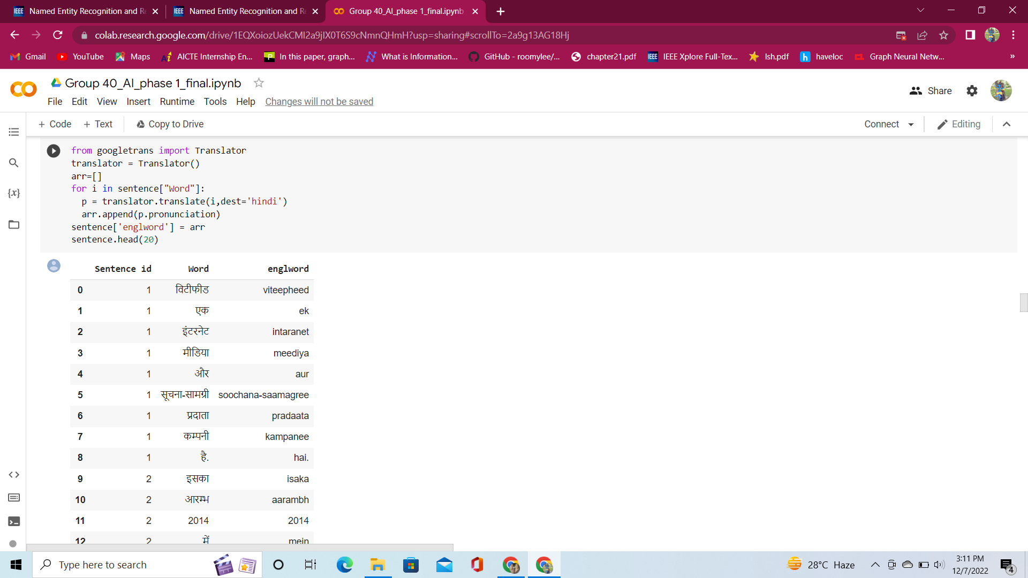

Slide 33
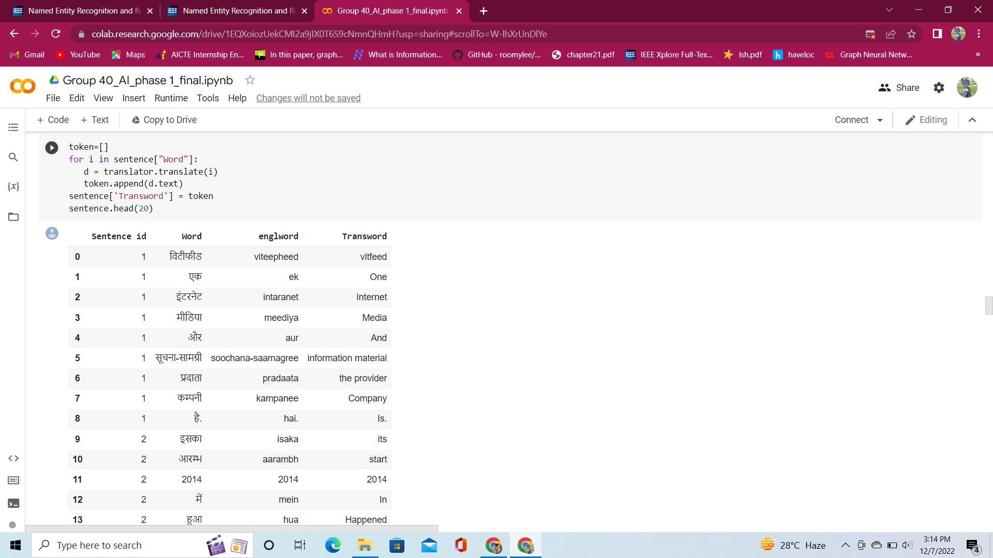

Slide 34
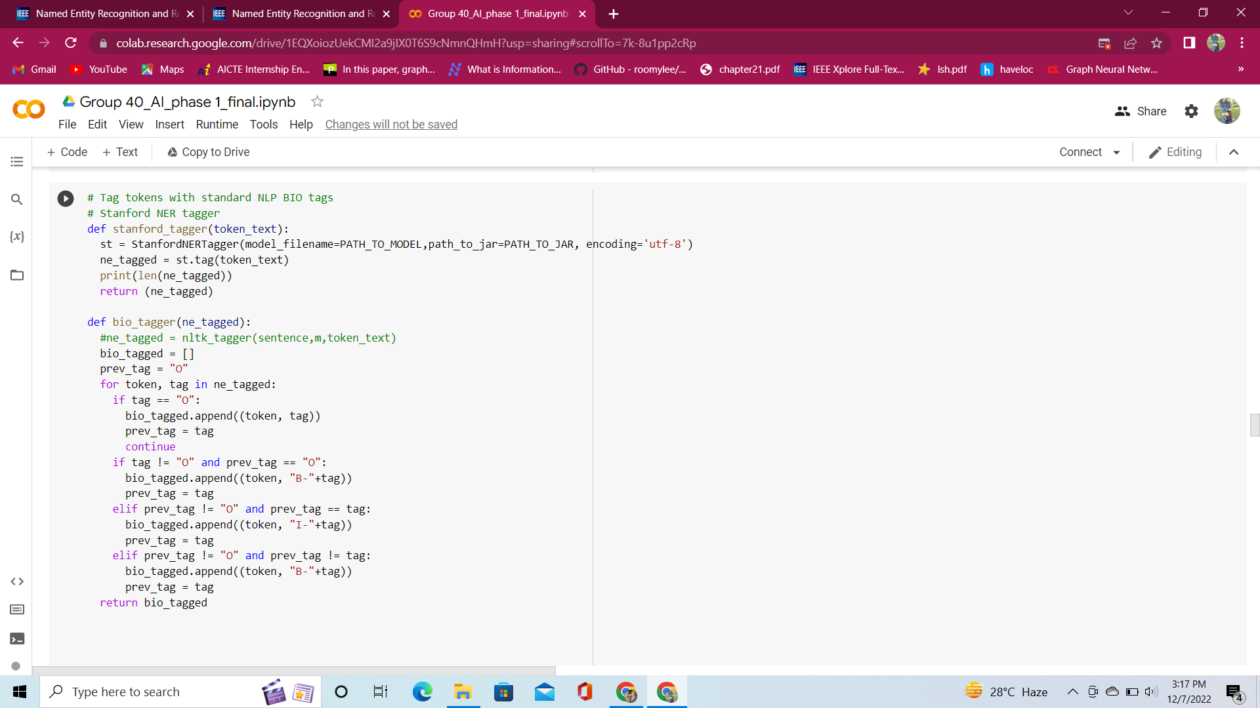
BIO Tagging

Slide 35
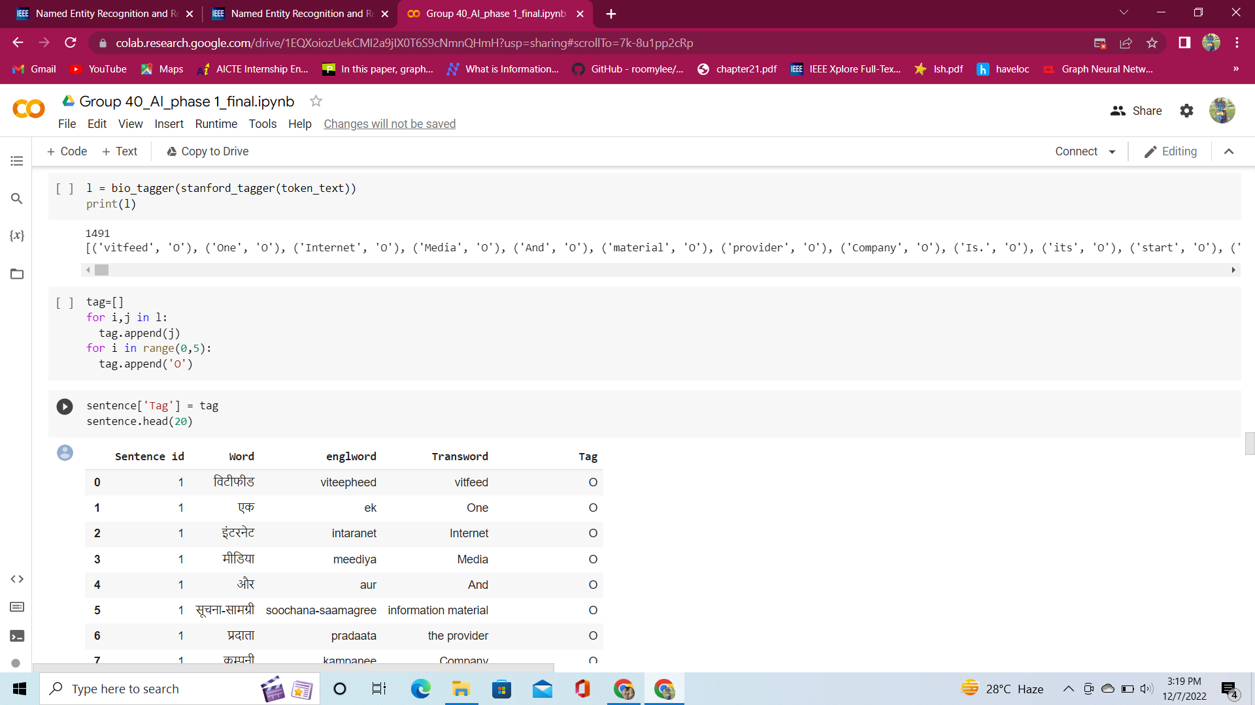

Slide 36
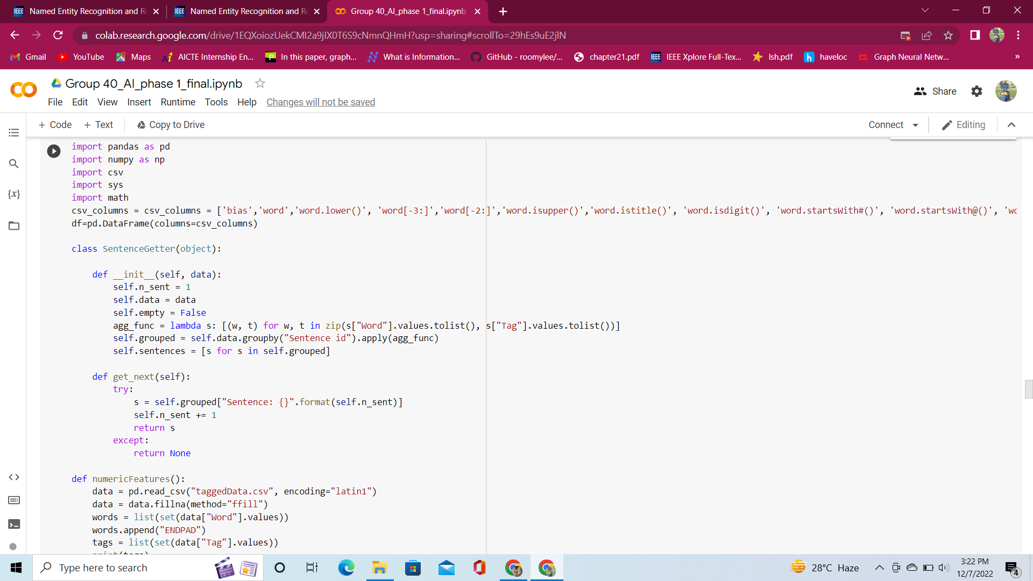
Numeric feature extraction

Slide 37
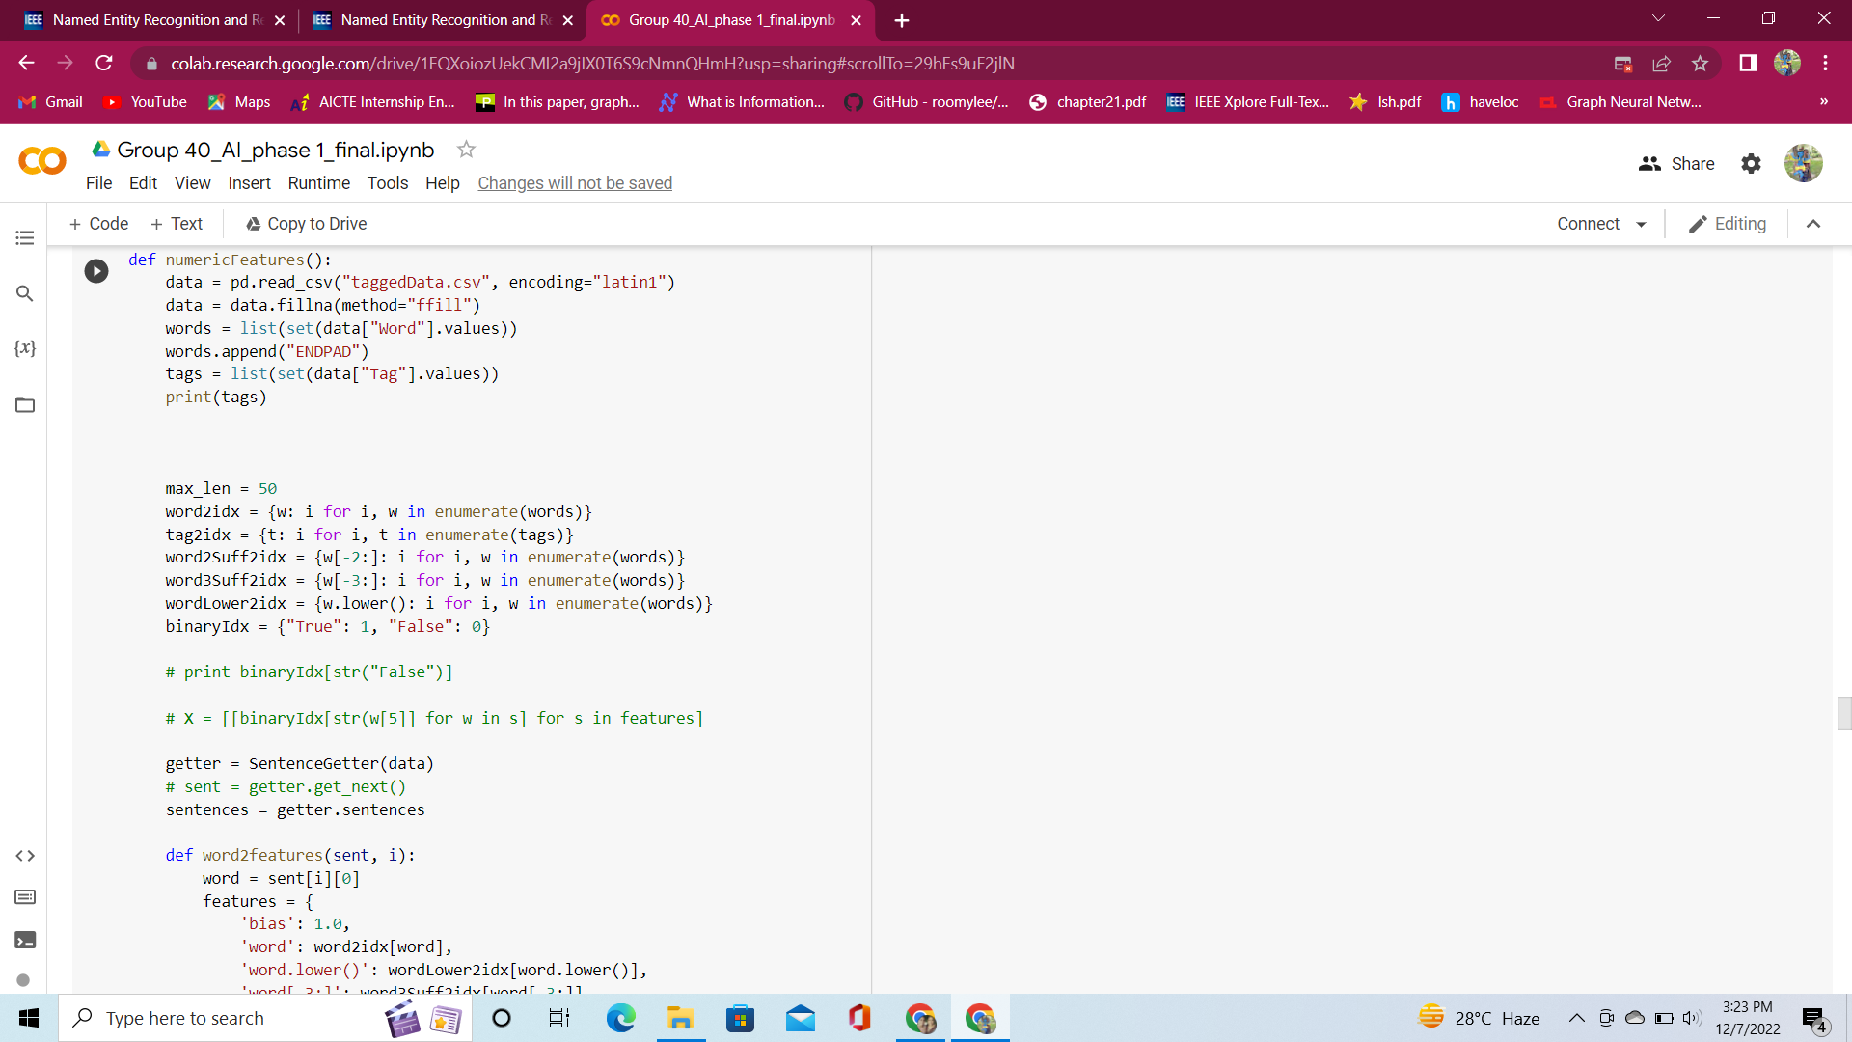

Slide 38
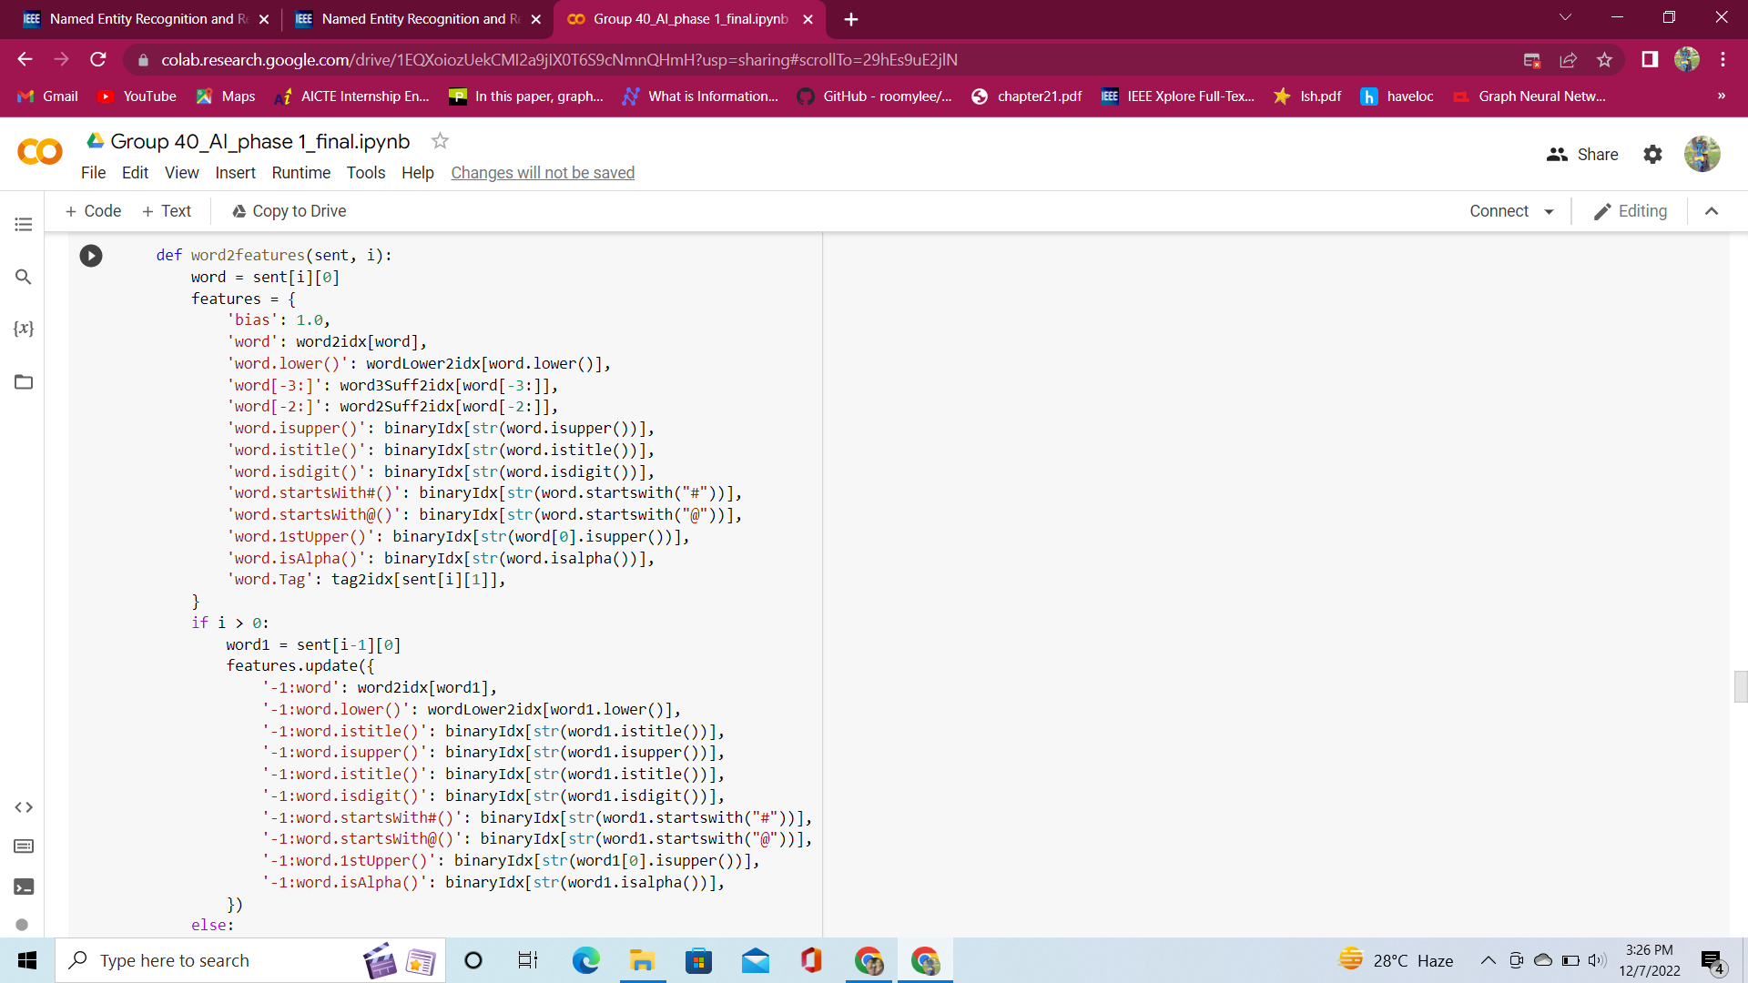

Slide 39
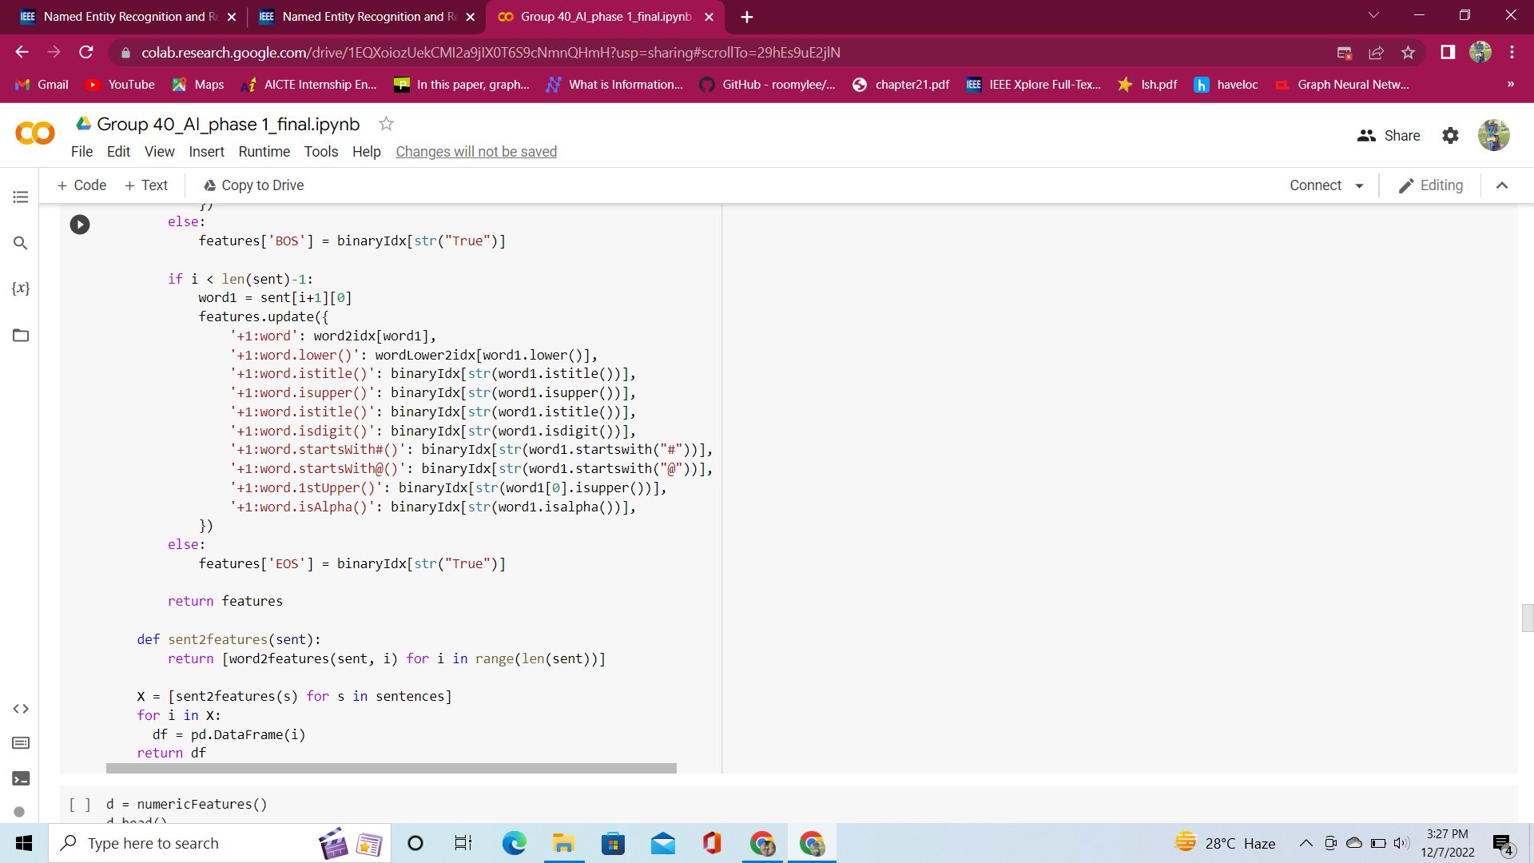

Slide 40
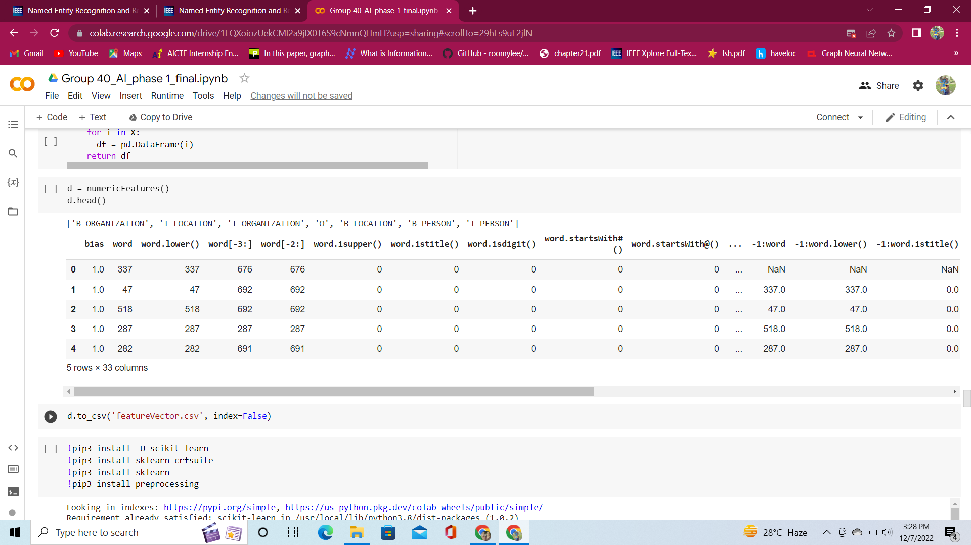
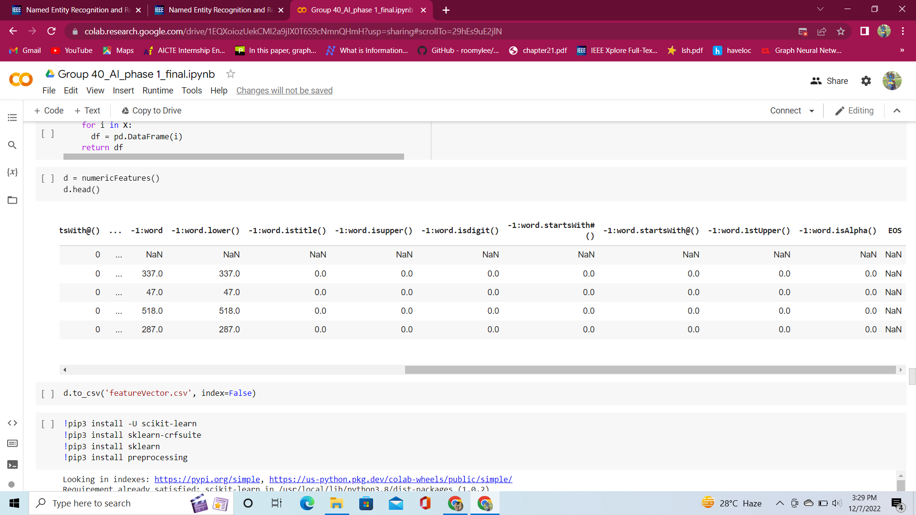

Slide 41
LSTM

Slide 42
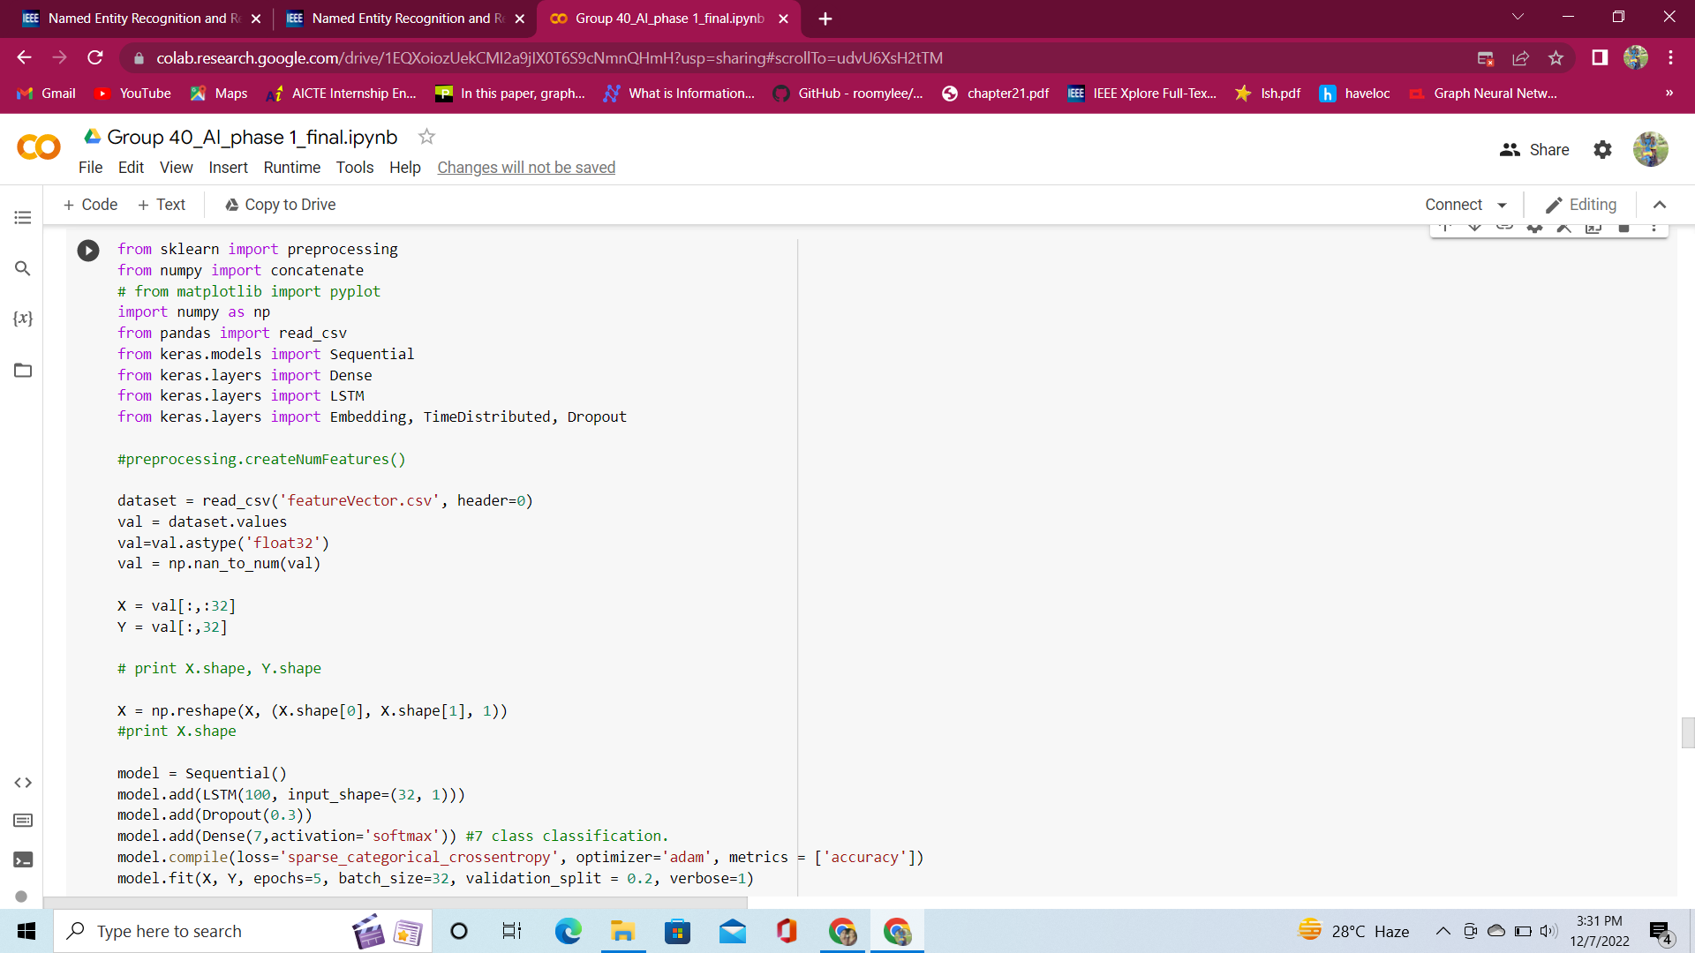

Slide 43
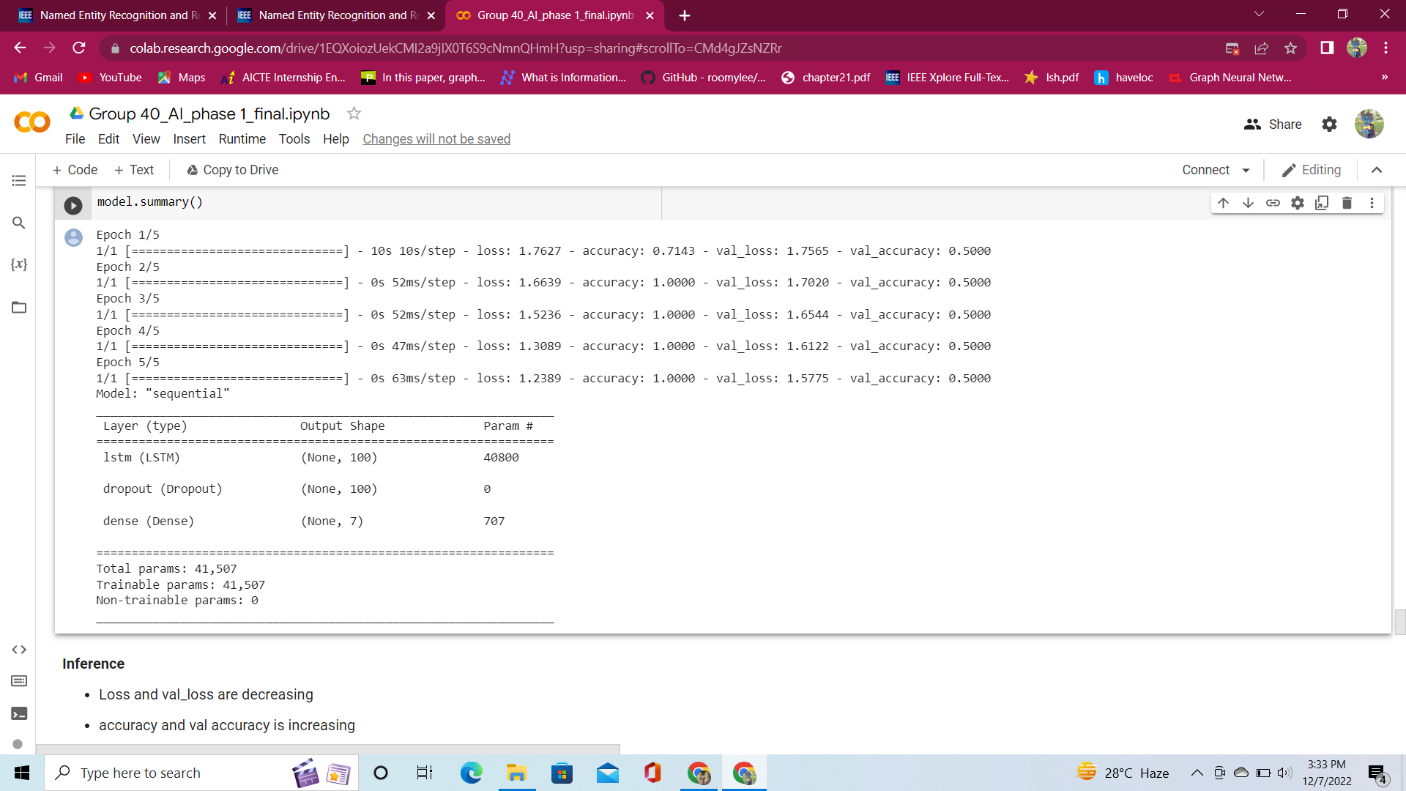

Slide 44
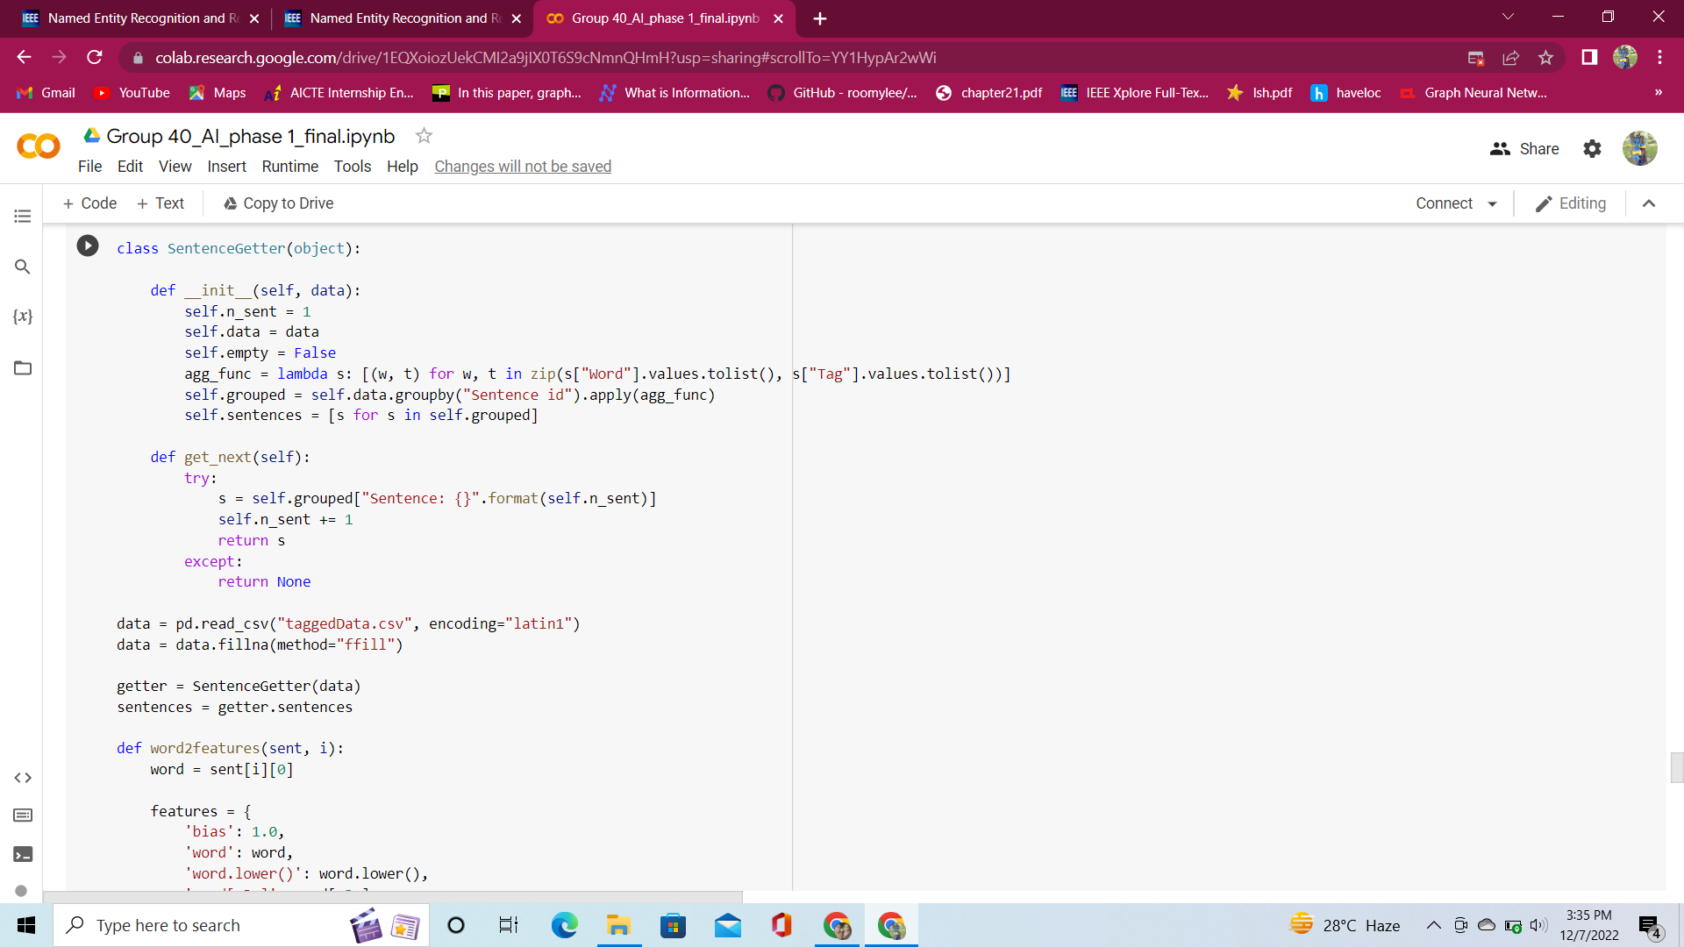
Decision Tree

Slide 45
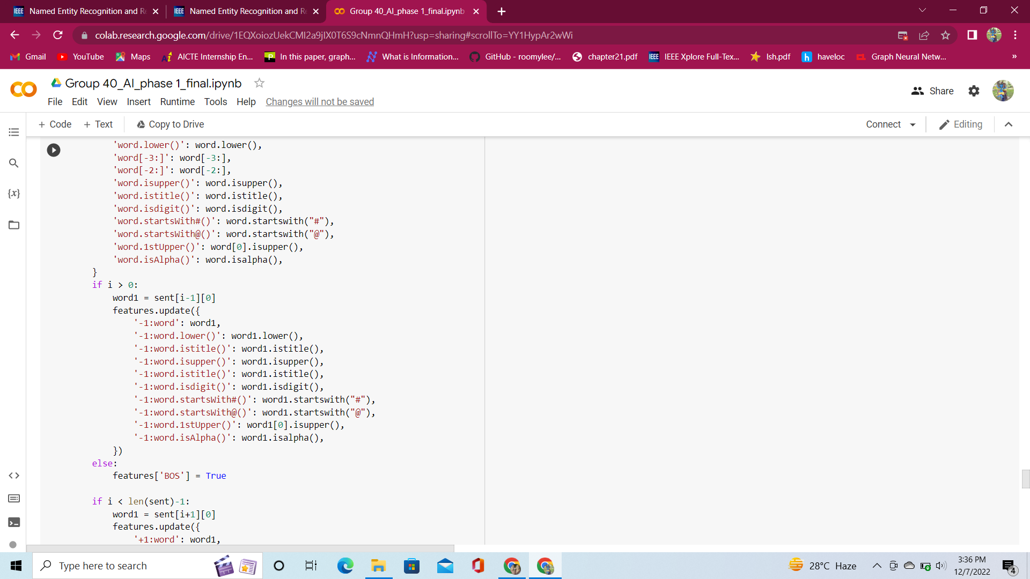

Slide 46
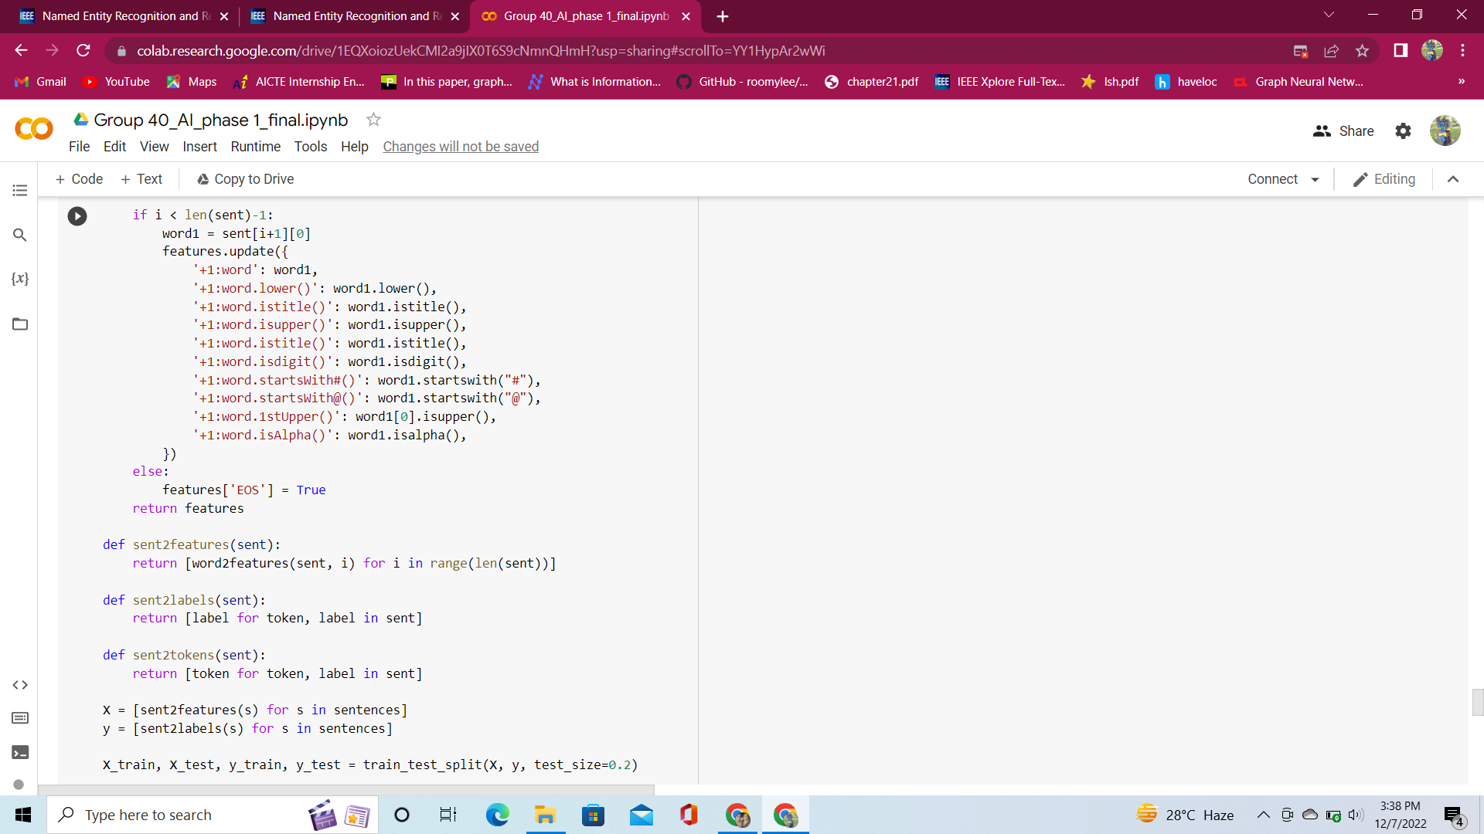

Slide 47
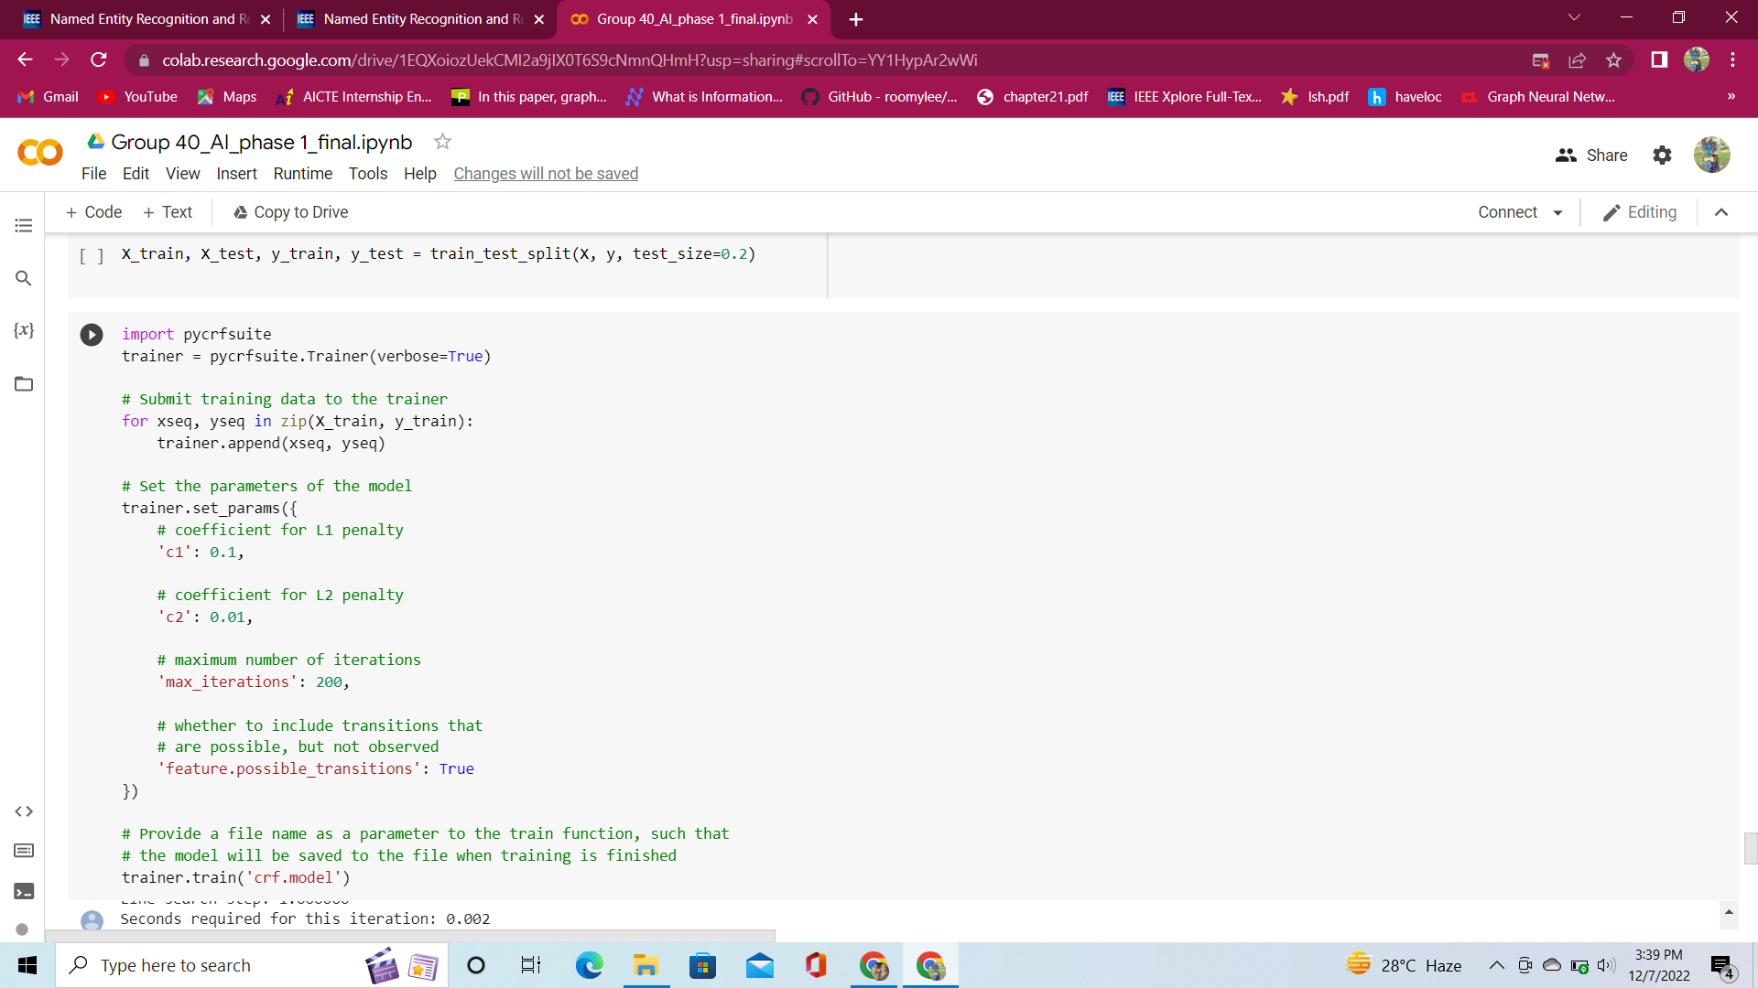
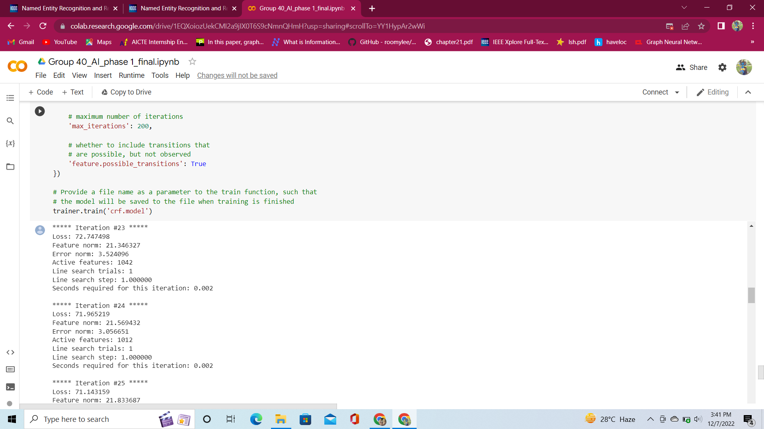

Slide 48
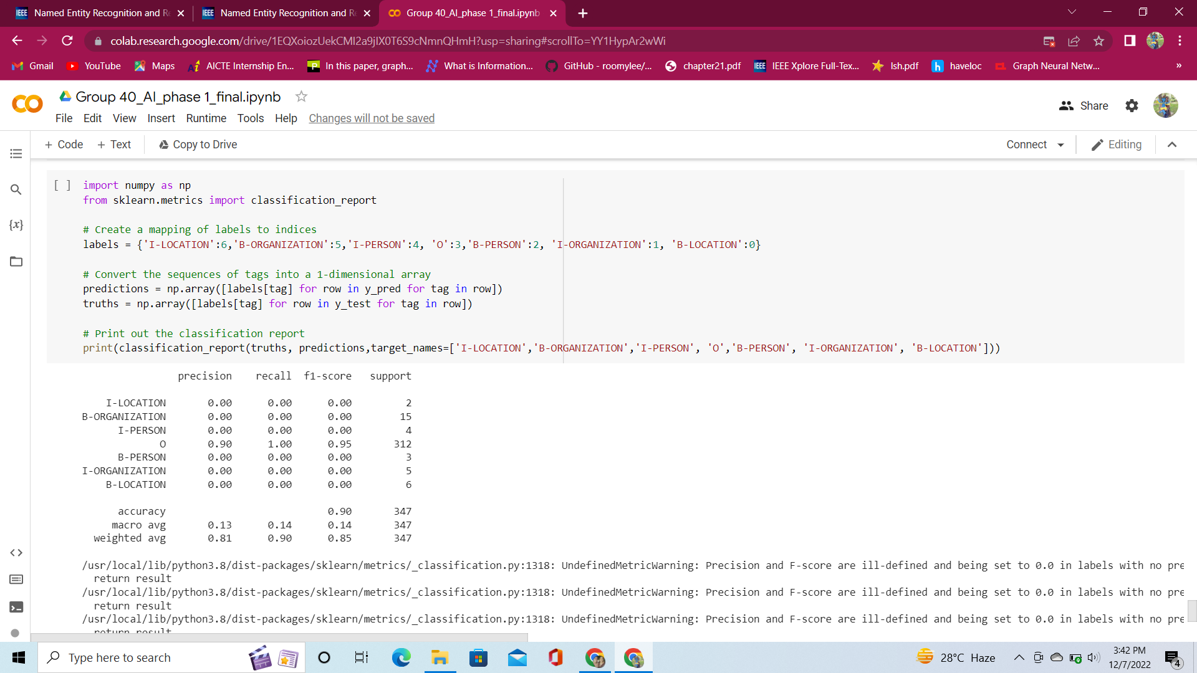

Slide 49
Results and Discussions
Bi - LSTM for Named Entity Recognition (NER)
Accuracy and validation accuracy are increasing as the epoch number increases. This shows that the model is working well. Loss and validation loss are decreasing from 1.7627 to 1.2389.
Decision Tree
Decision tree classifies the tokens to the 7 tags and checks the accuracy of the model. The F1 score accuracy is 90%.

Slide 50
Analysis and findings
Analysis and findings
Sentence segmentation
The sentences are segmented into words when a punctuation is encountered.
Tokenization
The paragraphs and sentences are split into smaller units (words) that can be more easily assigned meaning. The keywords were generated. The stop words in Hindi were dropped and the punctuations were removed.
Parts of Speech Tagging (PoS)
PoS tagging converts a word to a list of tuple (word, tag). Since it was a Hindi dataset, there were unknown tags. It was handled using google translate.
Named Entity Recognition (NER)
BIO Tagging
Each token is tagged to one of the seven standard NLP BIO – Beginner, Inside, Outside - tags (I - Location, B - Organization, I - Person, O, B - Person, I - Organization, B – Location). Using the BIO tags, numeric feature is extracted. It is then converted to numeric feature vectors.

Slide 51
Plan for Phase II
Implementation of GP GNN

Slide 52
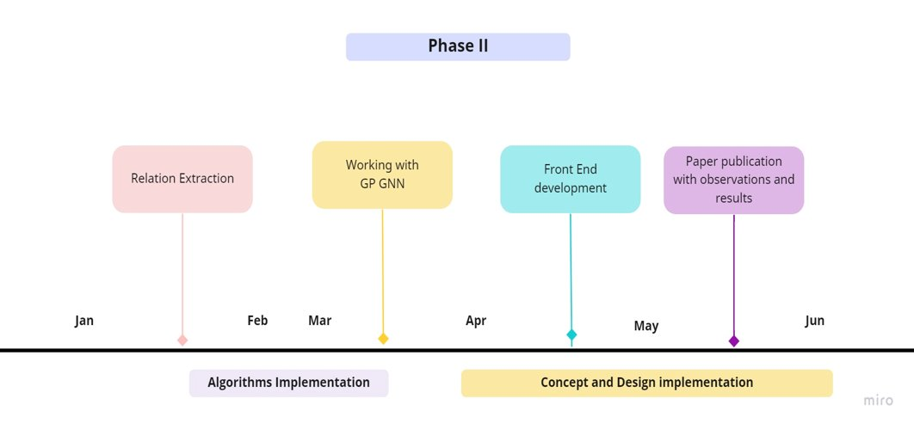
TIMELINE

Slide 53
conclusion
Most existing GNNs can only process multi-hop relational reasoning on pre-defined graphs and cannot be directly applied in natural language relational reasoning.
So we conclude that graph neural networks with generated parameters (GP-GNNs) is one of the most effective approaches for multi-hop relational reasoning in relation extraction which enables GNNs to process relational reasoning on unstructured text inputs.
Our proposed model, GP-GNN, solves the relational message-passing task by encoding natural language as parameters and performing propagation from layer to layer. It can be considered as a more generic framework for graph generation problem with unstructured input other than text.
We demonstrated its effectiveness in predicting the relationship between entities in natural language and bag-level.

Slide 54
REFERENCE
https://developpaper.com/in-this-paper-graph-neural-network-is-applied-to-named-entity-recognition-and-relation-extraction-of-semi-structured-documents/
https://www.researchgate.net/figure/The-taxonomy-of-Information-Extraction-b-Semi-Structured-Data-Semi-structure-means-that_fig1_224351589
https://youtu.be/y7sXDpffzQQ
https://youtu.be/ZKwYitIkSOE
https://www.researchgate.net/publication/352113408_RECON_Relation_Extraction_using_Knowledge_Graph_Context_in_a_Graph_Neural_Network

Slide 55
THANK YOU

